Slide 1
Graph-Based Detection
of Cooperative Dark Fleets
5-Minute Presentation
[Your Name] • February 2026

Slide 2
Motivation & Goal
IUU fishing fleets coordinate at sea
• Transshipment
• Shared fishing grounds
• Rendezvous with "dark" vessels (AIS off)
Goal: Surface candidate pairs WITHOUT labels
→ Unsupervised link prediction + validation

Slide 3
Approach (High-Level)
1. Daily AIS data 2012–2019 (2.38 billion records)
2. Build temporal graph (edge = <10 km same day)
3. Train Temporal GCN (TGCN) + temporal node features
4. Score missing links → multi-threshold validation
25 km ±1d | 50 km ±3d | 100 km ±7d

Slide 4
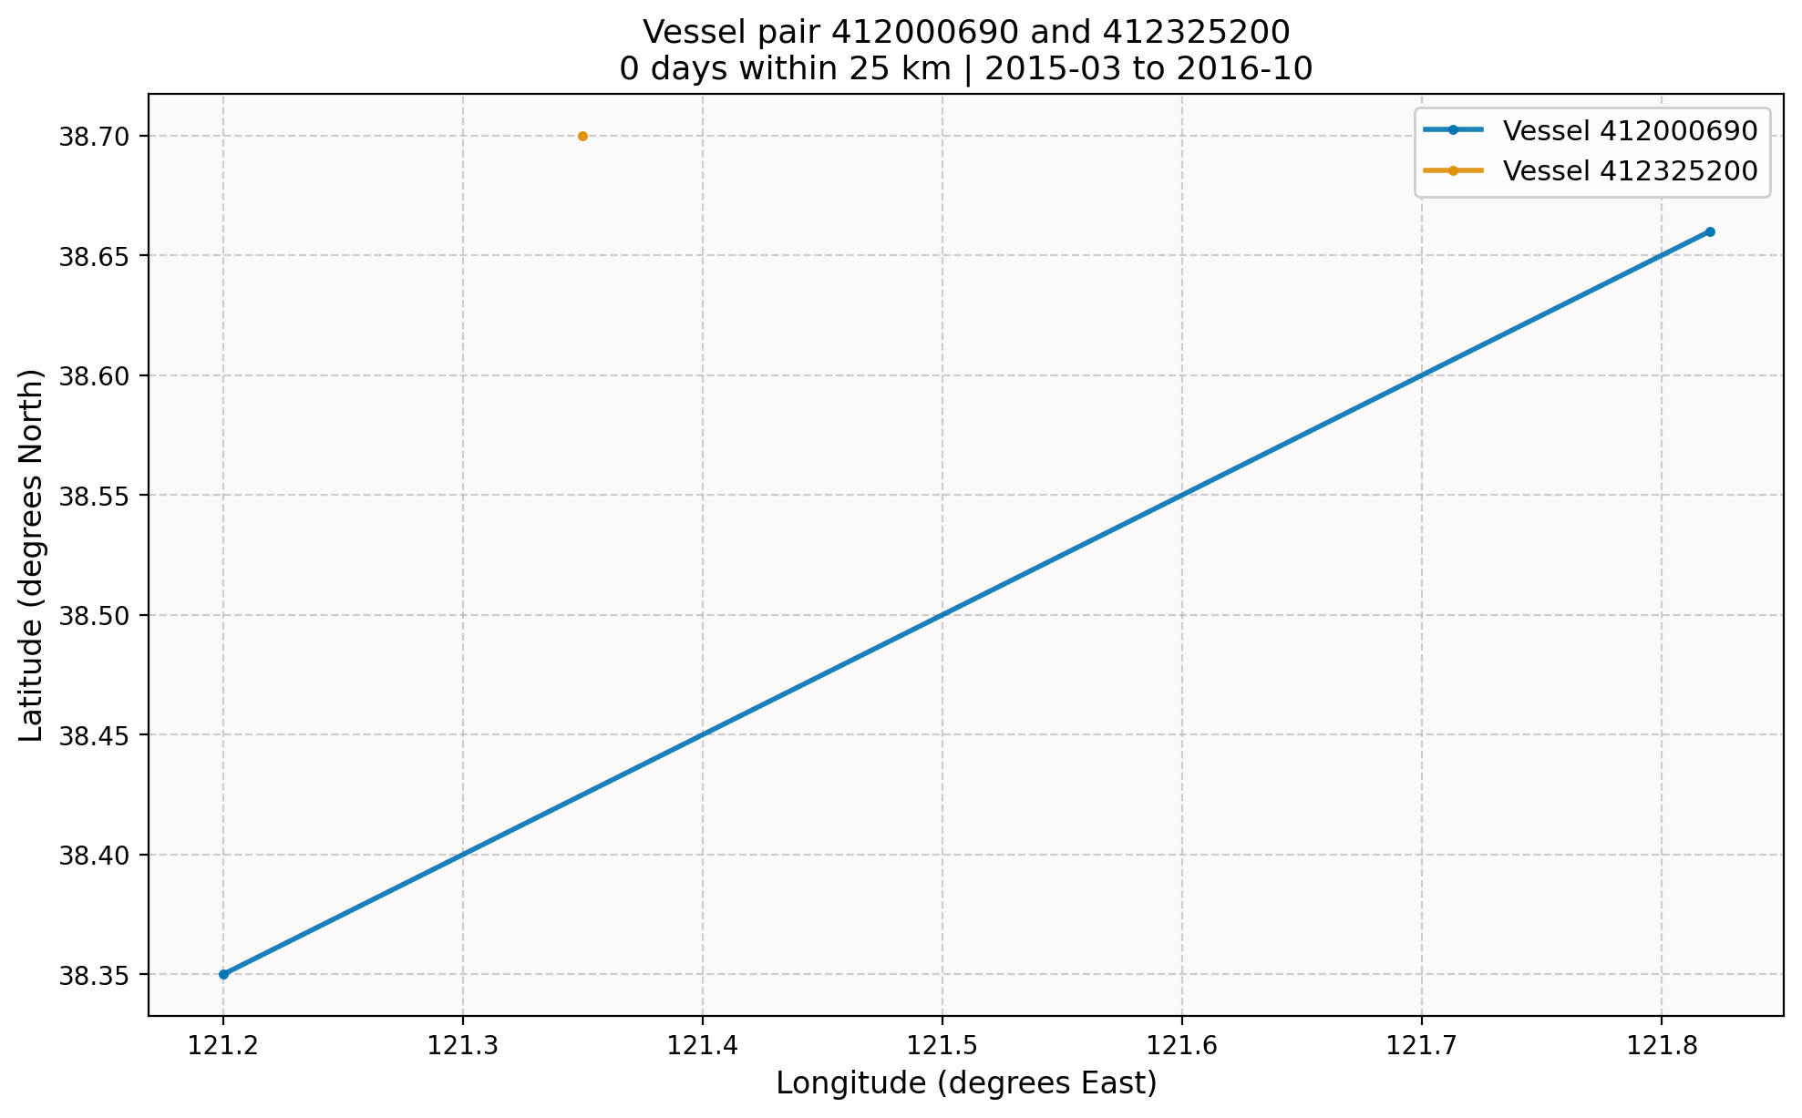
Results
Full-coverage model: ROC AUC ≈ 0.78
Capped reproducible: ROC AUC ≈ 0.95
5-fold CV: 0.927 ± 0.067
Strongest pair: 412000690 ↔ 412325200
→ 102 days within 25 km

Slide 5
Conclusion & Future Work
Reproducible pipeline that surfaces credible candidates
Ready for enforcement & research
Next steps:
• Finer resolution
• Vessel metadata lookup
• Supervised learning (if labels available)
Thank you! Questions?

